Slide 1
Spectrum Activity
The needs of human beings are more important than the needs of ecosystems.
When designing wildlife conservation projects, wildlife, not human beings, should be the focus.
Technology can solve the conservation field’s most difficult problems.
Many systems impacting wildlife conservation are just poorly designed.
Conservationists are the most likely group of people to know how to solve conservation problems.
Conservation problems can be well defined by science.
Human society and nature are two separate systems, and should be regarded as such when considering solutions to conservation challenges.
Communities are empowered to solve their own conservation challenges.
Notes:
There are a lot of diverging ideas about empathy in conservation. Here you may start to recognize and connect with you own attitudes towards conservation. Introspection can help you to see differing perspectives and foster empathy towards users. To what extent do you agree with these statements?
Instructions for the activity: 1. Read the statement out loud, and then everyone will move to one side of the room or another depending on the extent to which you agree with the statement.
(if remote -- you can have students stand up / sit down or put their hands all the way to the top/bottom of the screen depending on how much they agree, or share a whiteboard with the class so everyone can mark where they fall on the spectrum)
2. Discuss why you feel this way with your corner; then opposite sides share out.
3. Then, move on to the next statement.
Full list of statements (note: the slide is animated so these statements appear one by one):
Human society and nature are two separate systems and should be regarded as such when considering solutions to conservation challenges
The needs of human beings are more important than the needs of ecosystems.
When designing wildlife conservation projects, wildlife, not human beings, should be the focus.
Technology can solve the conservation field’s most difficult problems.
Many systems impacting wildlife conservation are just poorly designed.
Conservationists are the most likely group of people to know how to solve conservation problems.
Conservation problems can be well defined by science
Communities are empowered to solve their own conservation challenges

Slide 2
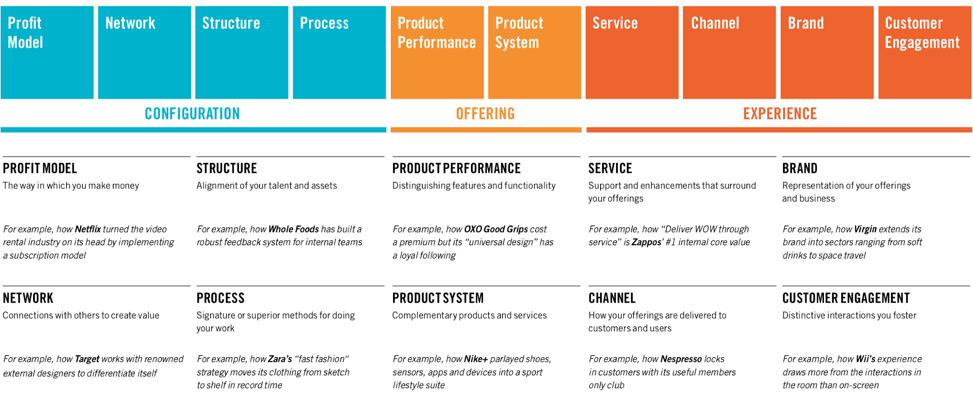
Doblin’s 10 Types of Innovation
Source: Doblin
Notes:
(Ref: Ten Types of Innovation)
Doblin’s framework here invites us to remember that when we talk about the Design Thinking process and how we get to groundbreaking innovations, we often jump to thinking about a product, usually a hardware or software, that looks flashy and new. But often, the breakthroughs with the biggest potential involve other types of innovation. Note that the tools we’ll practice (e.g. ideation, prototyping) can be applied to any of these types of innovation.
Debrief
Can you think of additional examples of companies that used these innovation types?
Do you see all of these as innovation? Are there some that inherently feel more or less innovative to you?
For a given example (e.g. recycling of plastics), let’s brainstorm what innovations in each of these dimensions might look like.
How might some of these innovation types relate to each other? For example, do Configuration innovations impact user Experience?

Slide 3
Risks and Critiques of Design Thinking
Opportunity Cost | Risk of incremental innovation or band-aids that address symptoms, potentially reducing attention to the root cause of the problem
Scale | Design Thinking was originally built to address niche user-defined problems, not systemic problems
Time-Stamped | Delivering users exactly what they ask for rather than more forward-looking solutions
Adaptation | Humans often adapt/conform to designs rather than the other way around
Source: Design Won’t Save the World
Notes:
Opportunity cost: Risk of incremental innovation or ‘Band-aids’: can remove pressure from governments when policy change is needed, or alleviate a symptom and make it easier to overlook a root cause.
Scale: Building on the above point: Human-Centered Design was built to address niche user-defined problems, not systematic problems. The laser-focused approach allows you to stay connected to your end user and move quickly in designing solutions, but it can also be quite myopic. This is why it’s so essential to really understand the system you’re designing for, before diving in to create a specific solution.
Time-stamped: When Design Thinking is executed poorly, there’s the risk of delivering users exactly what they ask for vs. truly innovative solutions. Skeptics often cite the Henry Ford quote, “If I had asked people what they wanted, they would have said faster horses.” (More detail here). On the other hand, this is an oversimplification of the design process: it’s not simply about asking users what they want and building exactly this. The nuance is in understanding the needs behind what they ask for, and finding innovative ways to deliver on the core of what they want.
Adaptation: Humans often adapt/conform to designs rather than the other way around. One example is ride-sharing: people who don’t have cars have adapted and gotten used to using public transport or bikes; when Uber and Lyft became available, car-based travel among these groups actually went up because it was more convenient for them.
(Ref: Design Won’t Save the World)
Debrief:
Which of these flaws do you see as fundamental limitations of design thinking, and which are just risks when design thinking is executed poorly?
What might we do differently to account for these flaws?
Connecting back to the questions of white saviorism and digital saviorism that were raised in the introduction module:
In what ways does the design process risk perpetuating digital saviorism?
What can we, as designers of solutions, do to be sure that they don’t perpetuate inequalities?

Slide 4
Activity: Who are you designing for?
1 | List your assumptions
 | In your project groups, draft a list of assumptions about your users and stakeholders. Consider their needs, daily life, values, history, etc. What might happen if these assumptions weren’t true? What might be risky or problematic?
2 | Discuss your assigned questions
 | Instructors will assign your group 2-3 questions from AirBnB’s Another Lens tool.
3 | Class discussion
 | Groups will present their assumptions, considerations from one of their questions, and takeaways to the class.
Notes:
Designers and researchers have often failed at adequately considering the needs of the users or beneficiaries of their work.
If design research fails to be inclusive, the process is run on incomplete knowledge -- making it impossible to design programs, services, or products that work for everyone. Or worse -- we might risk actually exacerbating inequalities through the ‘solutions’ we design.
Here you will explore questions that can help you create better solutions by challenging your biases and assumptions.
In this activity, each group has 2-3 different questions and then present 1 of their questions to the class. That way, everyone gets some quality time on 2-3 questions, and exposure to a larger set by way of their classmates.
Reference: Another Lens

Slide 5
Tips for Conducting Interviews
DO : |  | DON’T :
Start with broad questions, then go deep |  | Jump straight into highly technical questions
Treat interviewees as the experts (“Show me…”) |  | Try to sound smart
Ask open-ended questions, and ask “why” |  | Suggest answers.
Solicit specific stories (“Tell me about the last time you…”) |  | Invite generalizations (“How do you normally…”)
Have a semi-structured but flexible set of questions |  | Ignore context / body language
Notes:
As you think of who to interview, go back to your systems map. Consider who might engage with your solution: those that are affected by the problem, key stakeholders, and those that would use your solution. If you can, also try and interview some “extreme” users: those that fall outside the normal bell curve of the types of users you’d imagine engaging with your solution.
When you go out to interview, a couple of key tips:
START BROAD: Start off your interview with broad, general questions, to understand who they are as a person and what their priorities are. Build rapport and make sure they’re comfortable before you jump into more detailed, probing, or technical questions
TREAT THEM AS THE EXPERT: Keep in mind that your interviewees might be a bit nervous or intimidated; you want to put them at ease. The ideal dynamic to establish with interviewees is that they are the master, and you are the student. Where possible, ask them to show you how they do something, so that you can understand their current process and needs before jumping into re-designing it.
Don’t try to sound smart. It just risks biasing or intimidating them. Don’t be afraid to ask questions that sound dumb; it’s your job to learn from them, not to impress them. Don’t assume you know why they’re saying what they’re saying, how they feel, etc.; just ask follow up questions
ASK OPEN-ENDED QUESTIONS: Rather than closed (e.g. “yes/no” questions), ask open ended questions (how, what, where, why) that allow them to surface what’s important to them. Be careful of leading questions that might suggest answers or put words in their mouth. Try to challenge yourself to ask “why” a few times to a specific line of discussion to help you ‘peel back the layers’ of their response and find the true root cause of what they’re saying.
Do be sensitive: repeated “why’s” can, in some contexts, come off as a bit aggressive; if you sense your interviewee getting uncomfortable you might switch to gentler versions of the question. You might reframe “why” questions as “how” questions: e.g. “how did you realize this?”.
SOLICIT SPECIFIC STORIES as much as possible. Rather than asking them how they “normally” do something (which will lead them to overgeneralizations which are often unhelpful, ask them to tell you about a specific event, e.g. the last time they did something. In general, aim to ask about the present and past, rather than the hypothetical future; people are usually bad about predicting how they’d act or what they’d do in the future.
SEMI-STRUCTURED BUT FLEXIBLE: Prepare an interview guide with your key questions so that you can keep the conversation flowing, but don’t stick rigidly to a fixed set of questions. Read the context / body language of your interviewee and dig in to learn more in the areas they really care about.
At the beginning and end: always leave space for the interviewee to ask you some questions. You might even end with, “are there any questions that I should have asked you?”
Sources (these include many more tips and examples):
How to Conduct Empathy Interviews
User interviews done wrong
Get better data from user studies: 16 interviewing tips
How To Conduct User Interviews Like A Pro (UX Design)
Sample interview
IDEO U Creative Confidence Series: How to observe, interview, and uncover deep insights
Good and Bad Examples of Interview Questions
Lecture: How to Run a User Interview
Design Kit: 5 Whys

Slide 6
Interviews regarding illegal activities, or other sensitive topics
Build trust.
Engaging with communities that are tied to these activities requires compassion and tact. In some cases, trust must be earned before accessing the community for interviews, and to increase the probability of reliable information.
Consider vulnerabilities.
Carefully consider potential vulnerabilities of interviewees and establish a process to guarantee anonymity.
Consider the ethics of consent.
Extracting data without consent from stakeholders presents its own set of ethical challenges. Learn more on this in the Wild Tech module.
Notes:
When interviewing potential users or stakeholders it is important to remember that some of the conservation field’s most pressing challenges involve illegal activities, e.g., poaching, deforestation, overfishing.
Earn trust to get more reliable information
- Remember that communities’ livelihoods might be tied to these activities.
Consider vulnerabilities that interviewees might have, and consider how to guarantee anonymity.
- Talking to you shouldn’t put them at risk.
Consider whether you’ve gotten consent for the data you extract.
Learn more on this in the Technology for Environmental Impact Module and reference this for tips.
Resources:
Estimating Illegal Resource Use at a Ugandan Park with the Randomized Response Technique. Available from: https://www.researchgate.net/publication/249007607_Estimating_Illegal_Resource_Use_at_a_Ugandan_Park_with_the_Randomized_Response_Technique#fullTextFileContent[accessed Apr 02 2021].
UNESCO policy on engaging with indigenous peoples

Slide 7
Interview Practice
Remember to ask open-ended questions, and start broad, then go narrow.
1 | Develop your interview guide
 | Jot down a couple of questions you’ll ask your partner. We’ll split the class into 2 groups: Group A: will interview a partner about their recycling habits. Group B: will interview a partner about the sustainability of their diet.
2 | Interview a partner
 | Choose someone from the opposite group. Interview them for 10 minutes, then switch.
3 | Write a Point of View (POV) statement
 | Use the POV template to capture what you learned.
4 | Get feedback
Challenge yourself to ask “why” or “how” multiple times, to dig deeper.
Share feedback with the interviewer:
What worked?
What could have been better?
When did you feel most and least comfortable?
What should they have asked?
Imagine you had never met your partner before. What would your impression of them and their motives be?
Notes:
We’ll practice Interviewing to understand a users’ mindset and what is driving their behavior. You’ll get the chance to get feedback on your interviewing style, and also to see if you’re interpreting what you hear correctly. Do the insights that you walk out of an interview with feel on-target to those you interviewed?
Aim to pair students such that a person in group A is interviewing someone in group B, and vise versa; this makes the discussion a bit more natural since the interviewee has not just been writing questions regarding the challenge.
The POV template is here: https://drive.google.com/file/d/13O2C2hFhYZ-f0lG2AppoufPWR7BQFNm7/view?usp=sharing
Debrief together:
Did you feel like you were able to break through and get to what your partner really cared about, rather than just what they thought they should say?
Who asked their partner X?
Who can articulate a goal that is actually your partner’s, and not what you think / society thinks should be their goal?

